Slide 1
Class Project
Jeremy Bergmann - Omaha Data Science Academy

Slide 2
Purpose
To create an end-product that’s similar to what would be produced in a business environment, utilizing the knowledge gained in this course.
Steps – Data Science (CRISP-DM) Process
Understand Business Problem (What should you solve for?)
Understand Data
Prepare Data
Select Model, Build Model & Create Data Flow
Test/Evaluate Process
Deployment - Answer business questions, Generate additional questions

Slide 3
Project Milestones
Select NLP Application & Search for data (Class 2)
Utilize Scikit Learn to explore & process dataset (Class 3)
Evaluate & Select Word2Vec NLP Model(s) (Class 4)
Build Word2Vec NLP Model (Class 5)
Create Data Pipeline using Python and/or Dataiku (Class 6&7)
Ask questions/finish project for professional portfolio (Class 8)

Slide 4
NLP Applications
Application | Description | NLP Model
Text Classification | Given an example of text, predict a predefined class label. | Word2Vec – LDA & LSA
Language Modeling | Predict the next word, given the previous words. | SciKit Learn – Language Identification
Speech Recognition | Understanding what was said by the speaker. | Difficult – Need Speech Recognition Hardware
Caption Generation | Given a digital image, such as a photo, generate a textual description of the contents of the image. | Keras/TensorFlow https://machinelearningmastery.com/develop-a-deep-learning-caption-generation-model-in-python/
Machine Translation | Converting a source text in one language to another language. | Keras/Tensorflow https://towardsdatascience.com/neural-machine-translation-with-python-c2f0a34f7dd
Document Summarization | A short description of a text document is created. | NLTK https://stackabuse.com/text-summarization-with-nltk-in-python/
Question Answering | Given a document of text, answer a specific question about the subject. | Scikit Learn – SQuAD Dataset https://towardsdatascience.com/nlp-building-a-question-answering-model-ed0529a68c54

Slide 5
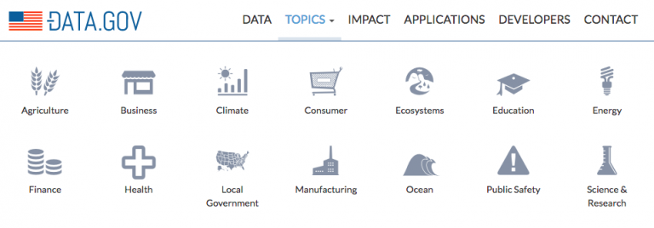
Project Data Sets - Text
Examples
Consumer complaints data (.csv)
Gensim Word2Vec Test Data
NLP Datasets - Github
Create/Scrap your own!
  API
  Scraper
  Exisiting Documents
Notes:
Obj: 9, 10, 11
Recall the objective of learning and using SQL: ask and answer relevant questions
Map DBs, practice joins, extract dates

